Slide 1


Mediated Social Interpersonal Communication Evidence-based Understanding of Multimedia Solutions for Enriching Social Situational Awareness
CUbiC
CENTER FOR COGNITIVE UBIQUITOUS COMPUTING
Sreekar Krishna
Committee:
Dr. Sethuraman (Panch) Panchanathan, Chair
Dr. Baoxin Li Dr. Michelle (Lani) Shiota
Dr. Gang Qian Dr. John Black
ARIZONA STATE UNIVERSITY

Slide 2
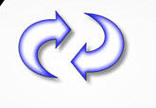
Scope of this dissertation
Multimedia Technologies
Interactions between individuals
Physically isolated.
Sensory deprived.
Sensory overload.
Communication breakdown.
Evidence-based understanding of the social interaction enrichment technologies
What are the requirements of the users?
How valid are these requirements given the various theories around human interpersonal communication?
How can multimedia technologies augment towards delivering these needs?

Slide 3
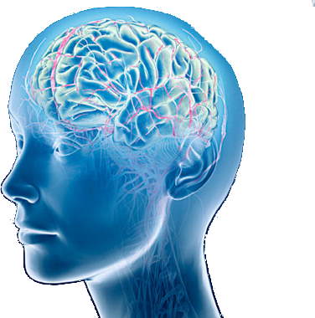
Social Interactions
Social Situational Awareness
Face
Body
Social Cognition
Social Reciprocation
Social Hearing
Voice
Social Sight
Social Touch
Social Stimulation
Social Stimulation
Social Cognition
Social Reciprocation

Slide 4
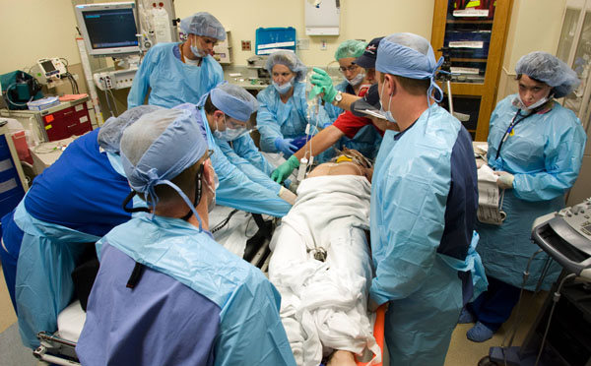
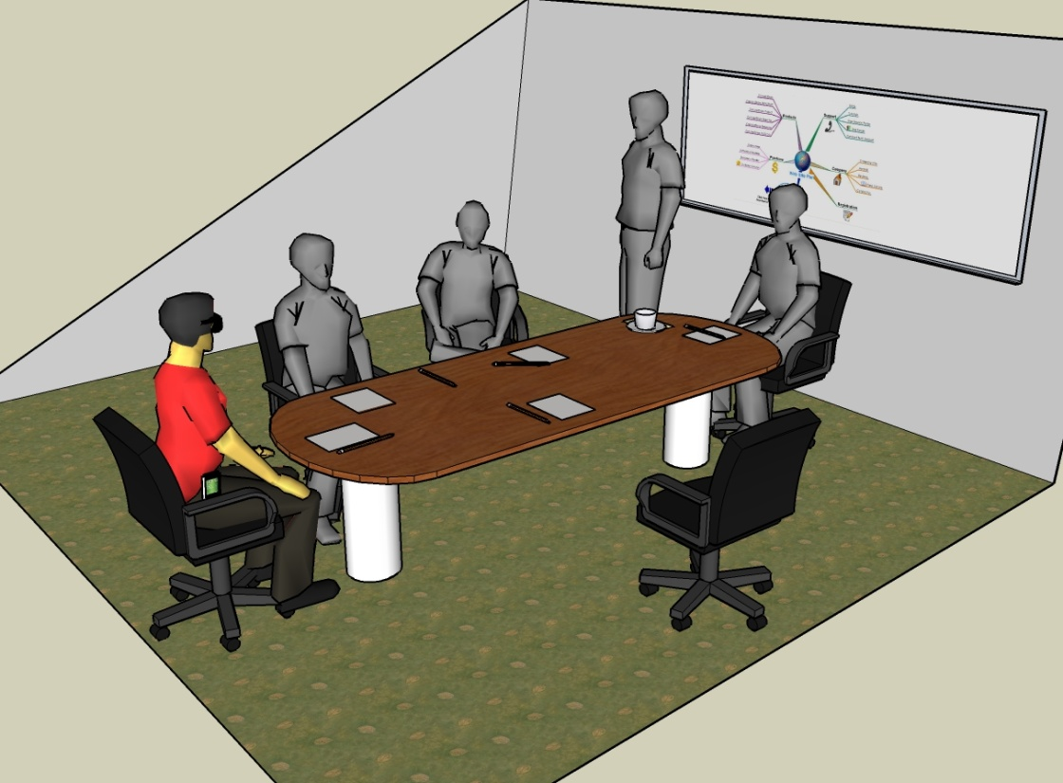
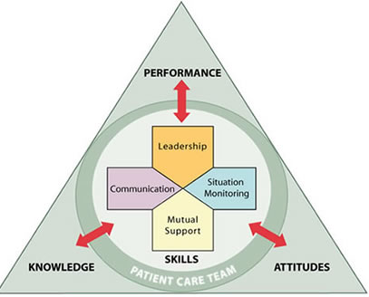
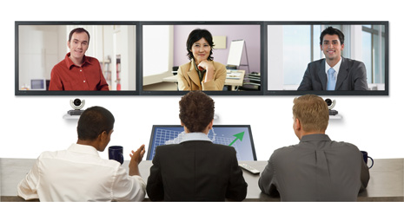
SSA in Various Settings
Social Assistance
Decision Making
Remote Collaborations
TeamSTEPPS
How many people?
Where are they located?
What are their facial expressions?
Eye Gaze
Eye Contact
Body Mannerisms
Expressing Opinion
Managing Conflict
Making Decision
Speed of Decision
Interaction with Colleagues
Difficulty Establishing Rapport
Leadership
Mutual Support
Communication
Attitude
Situation Monitoring
Patient Safety

Slide 5
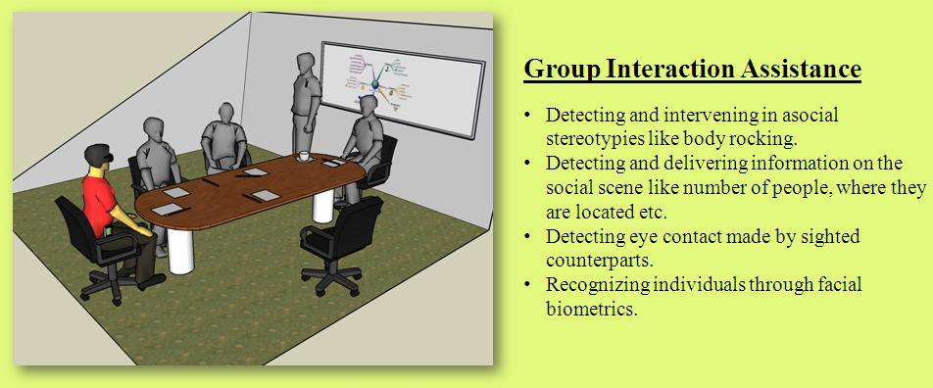
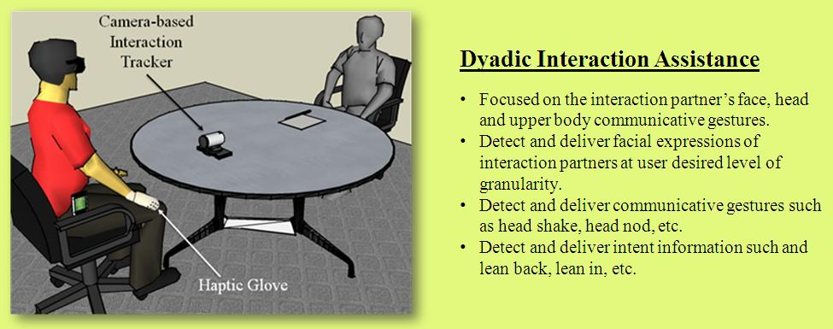
Group Vs. Dyadic Interactions

Slide 6
Case Studies of People who are Blind
Sara
Jindal-Snape
CUbiC open focus group
Studies on a college student’s interaction with technology
8 important factors identified
Most important dimension was sociability with visual community
Studies with children who are blind
Difficulty in learning due to lack of social feedback
Important to provide assistance and rehabilitation
“It would be nice to walk into a room and immediately get to know who are all in front of me before they start a conversation”.
One young man said, “It would be great to walk into a bar and identify beautiful women”.
Dr. Terri Hedgpeth
“Without social skills, there is no professional success.”

Slide 7
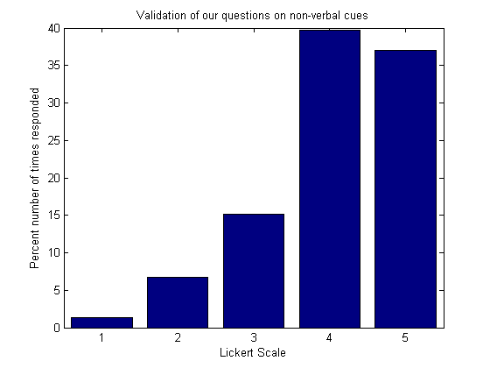
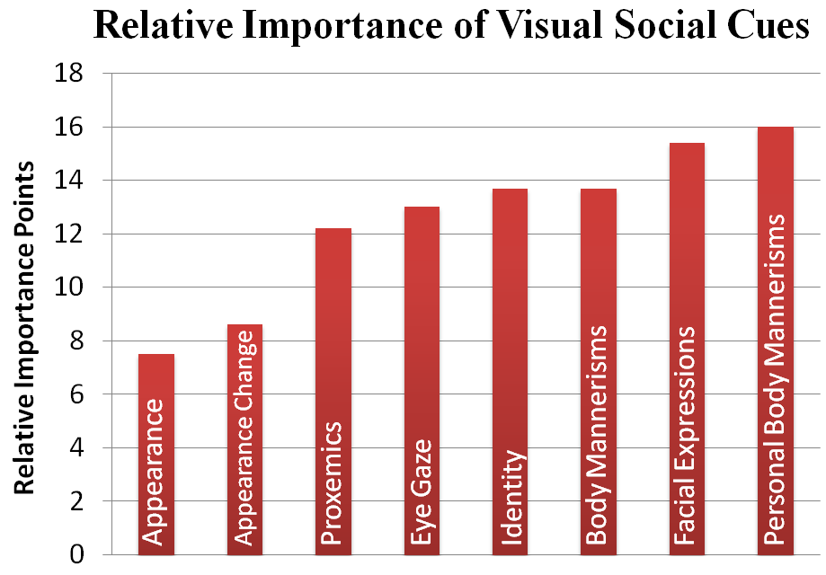
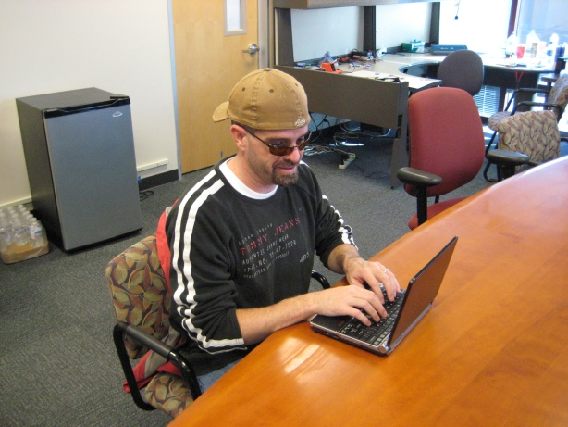
Self-Report Importance of Non-Verbal Cues
Statement Number | Need
1 | Knowing how many people are standing in front you, and where each person is standing.
2 | Knowing where a person is directing his/her attention.
3 | Knowing the identities of the people standing in front of you.
4 | Knowing something about the appearance of the people standing in front of you.
5 | Knowing whether the physical appearance of a person who you know has changed since the last time you encountered him/her.
6 | Knowing the facial expressions of the person standing in front of you.
7 | Knowing the hand gestures and body motions of the person standing in front of you.
8 | Knowing whether your personal mannerisms do not ﬁt the behavioral norms and expectations of the sighted people with whom you will be interacting.
Focus Group on 8 Social needs
27 participants - 16 blind, 9 low vision and 2 sighted specialists.

Slide 8
Contributions from this Dissertation
Stereotypic mannerism
Body mannerisms
Identity
Proxemics
Gaze based attention
Change in physical attributes
Physical attributes
Facial Expressions
8
8
7
6
6
7
Ground Work in Social Assistance
5
3
Importance
4
1
3
2
2
5
1
4
Feasibility
High

Slide 9
Stereotypy
Any non-functional repetitive behavior
Two main causes for stereotypy
Lack of sensory feedback
Lack of cognitive feedback
Methods of control Stereotypy
Intervention
Curtail Behavior immediately
Reward / Punishment
Self Monitoring
Do not intervene directly
Develop cognitive replacement
Body Rocking is the most prevalent stereotypy for people who are blind and visually impaired

Slide 10
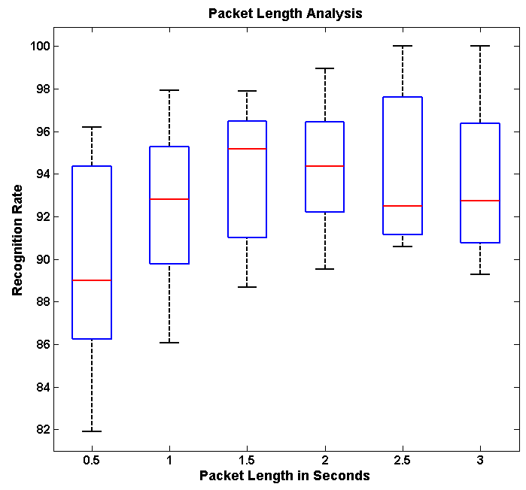
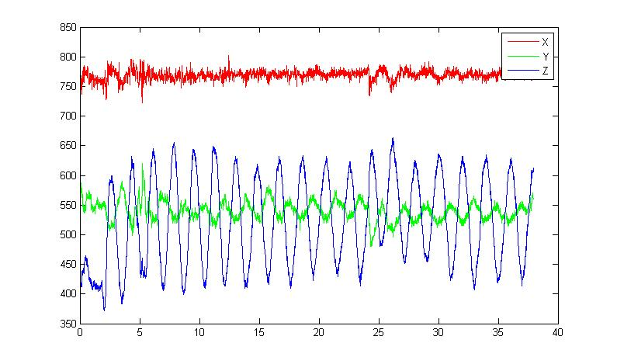
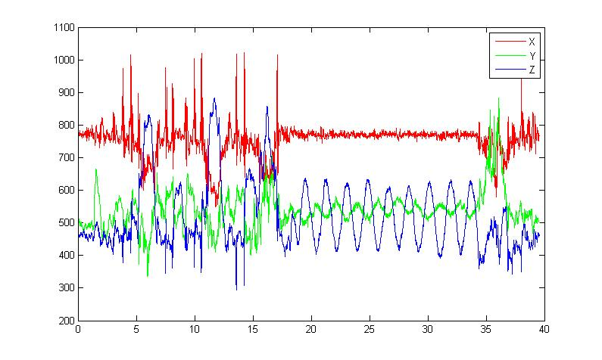
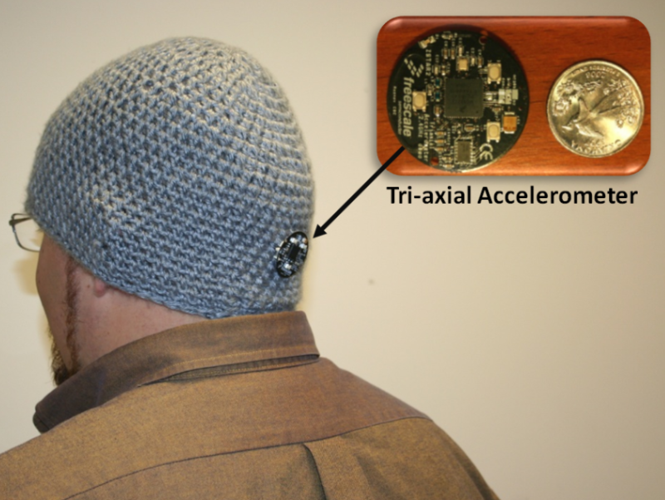
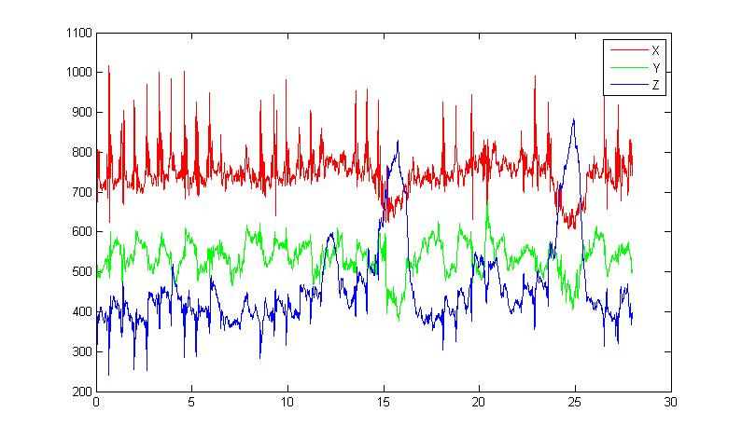
Proposed solution
Rocking
Z
Non - Rocking
Y
Rocking action can be recognized with an accuracy of 94% within 2 seconds
X
Behavioral Psychology literature shows that one rock action is approximately 2.2 seconds long. Effectively, recognizing a rocking behavior well within one rock cycle.

Slide 11
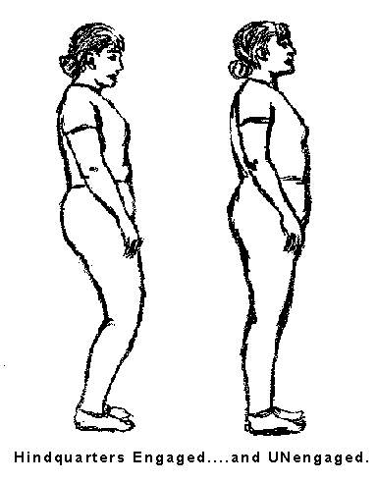
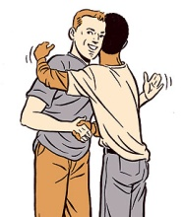
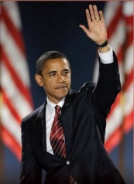
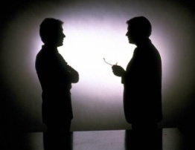

Social Gaze & Interaction Space
Interpersonal Space
0’
1.5’
4’
12’
25’
Intimate
Social
Personal
Public

Slide 12
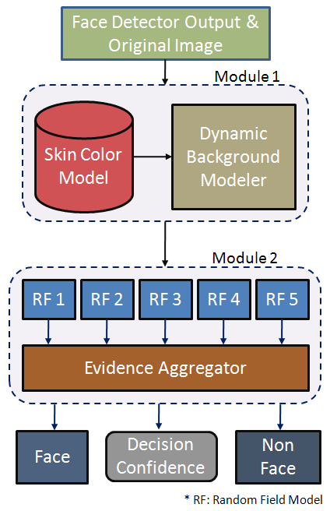
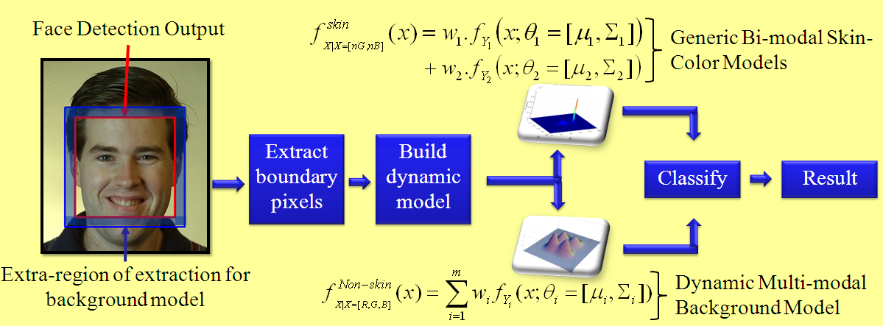
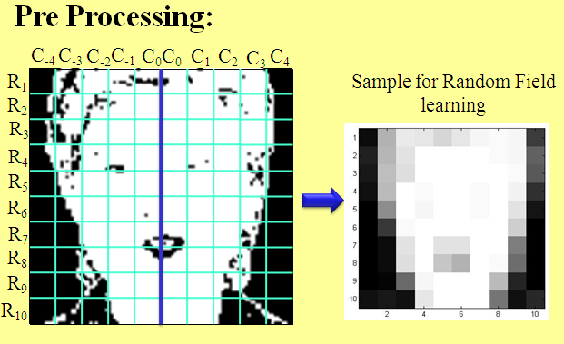
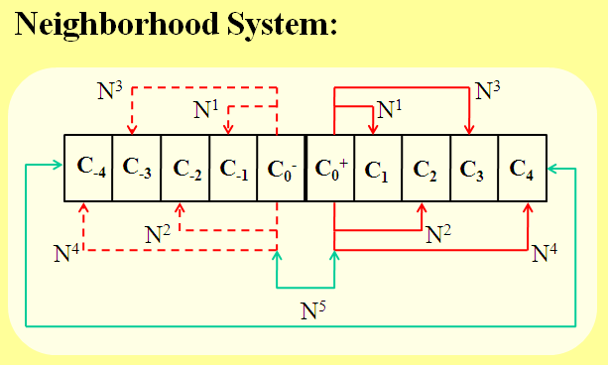
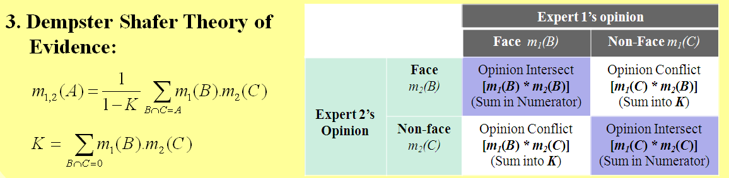
Modeling Distance & Direction through Face Detection
Module 1: Color Analysis
Module 3: Evidence Aggregation
Module 2: Markov Random Field LPCD

Slide 13
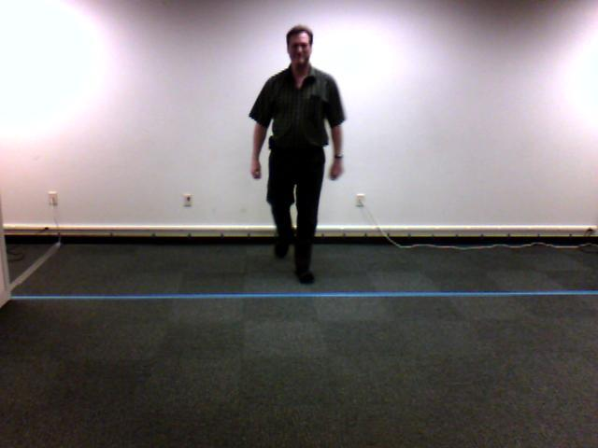
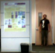
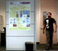
Structured Mode Searching Particle Filter (SMSPF)
Step 1
Step 2
Motivation: Weak Temporal Redundancy
Motivation:ComplexObject Structure & Abrupt Motion
Approach: Deterministic Search over a small probable search space (Histogram of Gradients with Chamfer Match)
Approach: Stochastic Search over
a large search space (Color Histogram Comparison)
Result: Approximate Estimate
Initial Estimate
Corrected Estimate
Example Search Windows
Result: Accurate Estimate

Slide 14
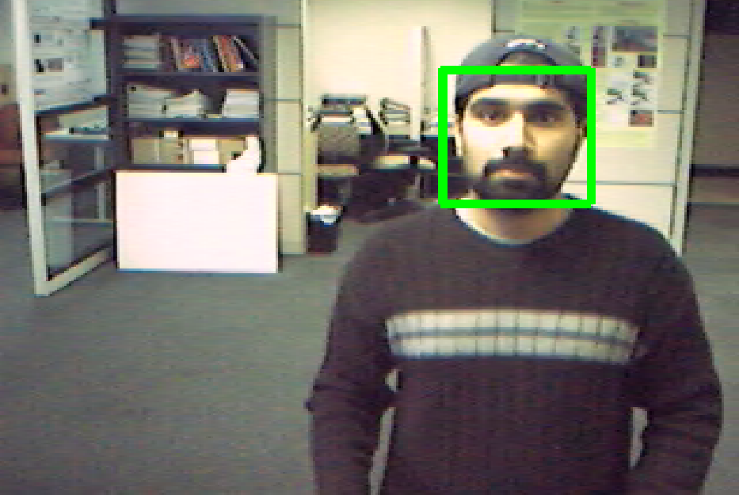
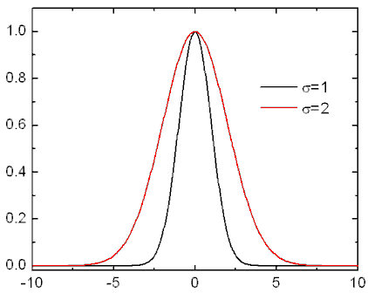
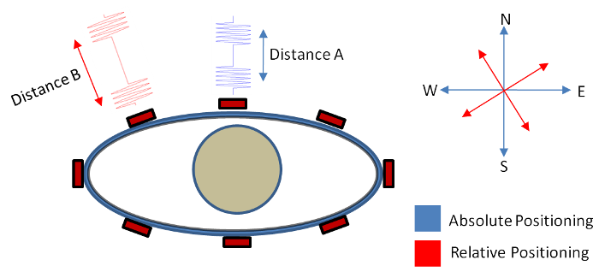
Face/Person Detection/Tracking
Face Detection
Person Detection
Tracking
Model
Deliver

Slide 15
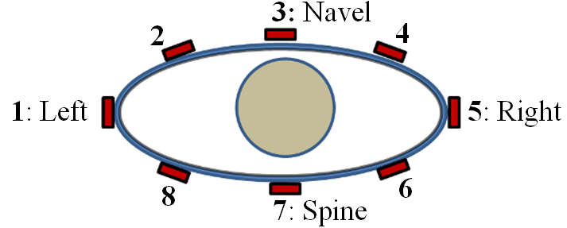
Social Scene Delivery System

Slide 16
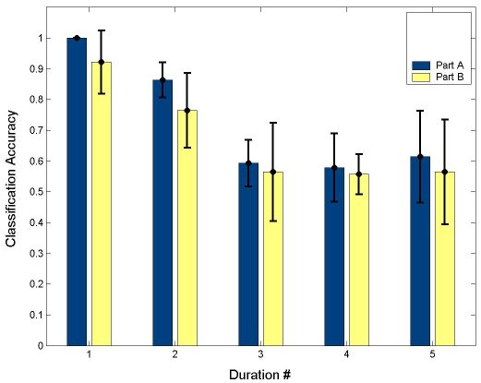
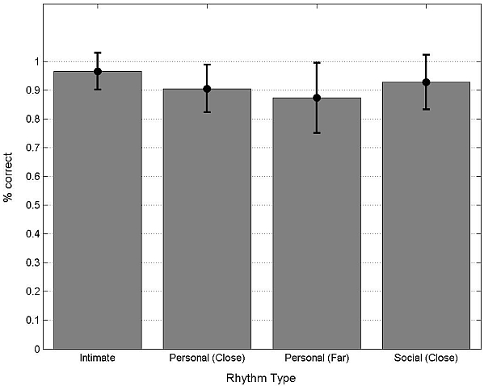
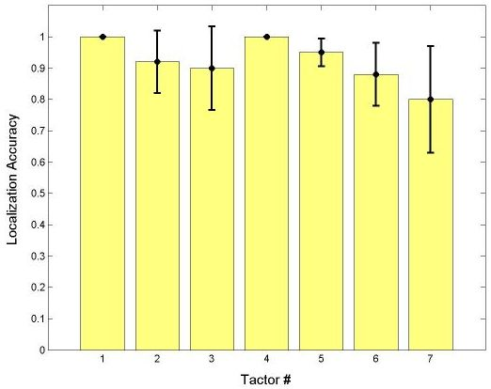
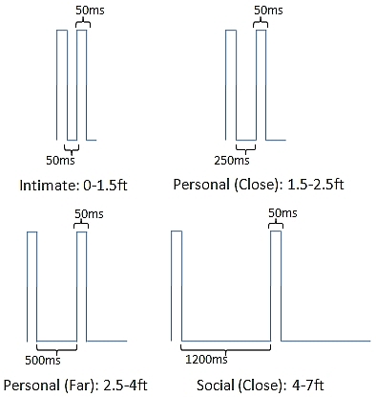
Social Scene Information Delivery
Easy Learn
Interaction
Partner
Number
Easy Recall
Haptic
Annunciator
System
Distance
Somatosensory Encoding
Intuitive
Direction
Hard to Overlook

Slide 17
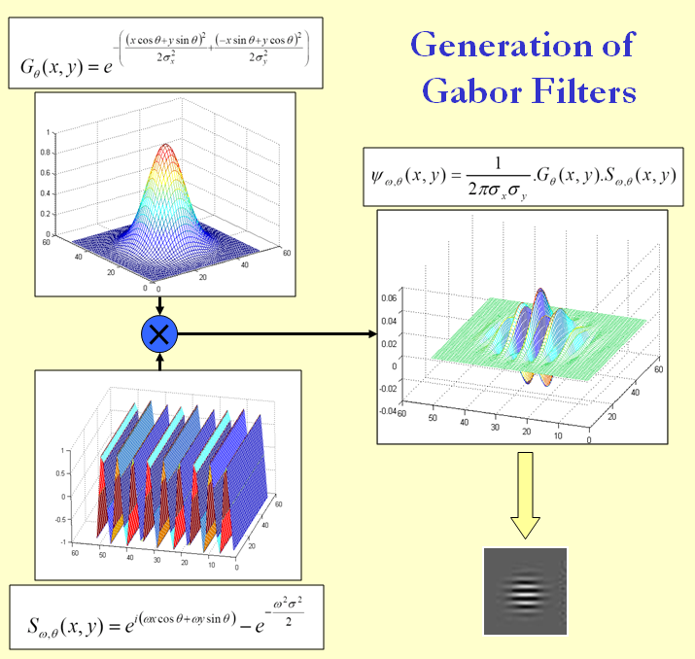
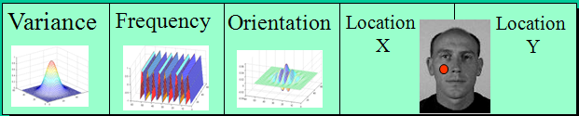
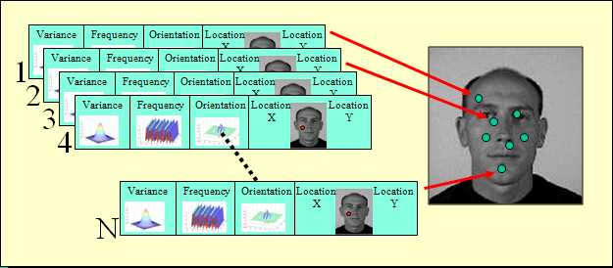
Person Specific Feature Selection
Chromosome:

Slide 18
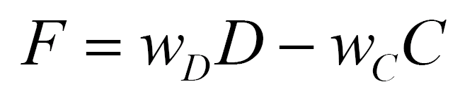
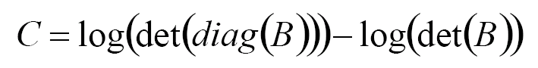
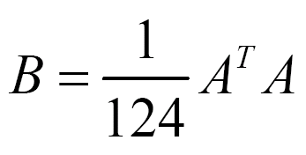
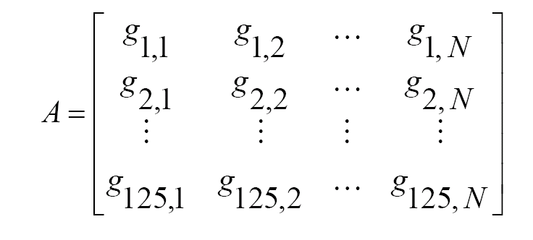
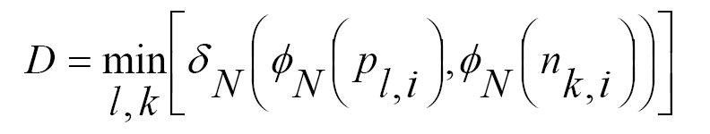
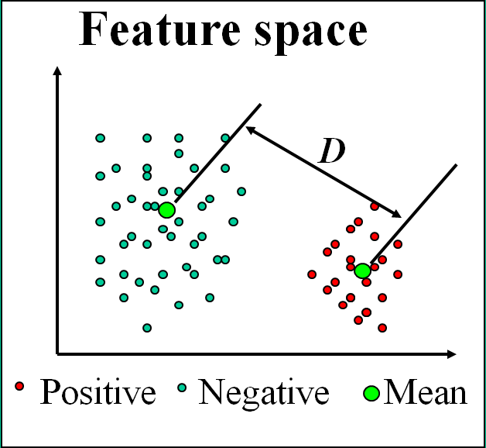
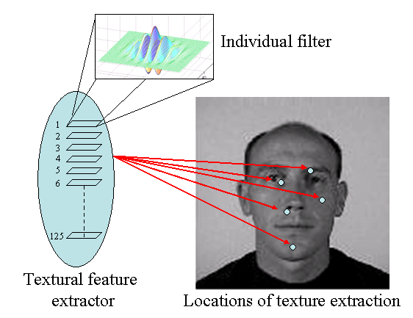
Person-Specific Feature Selection
Fitness Function:
Correlation Metric:
Distance Metric:

Slide 19
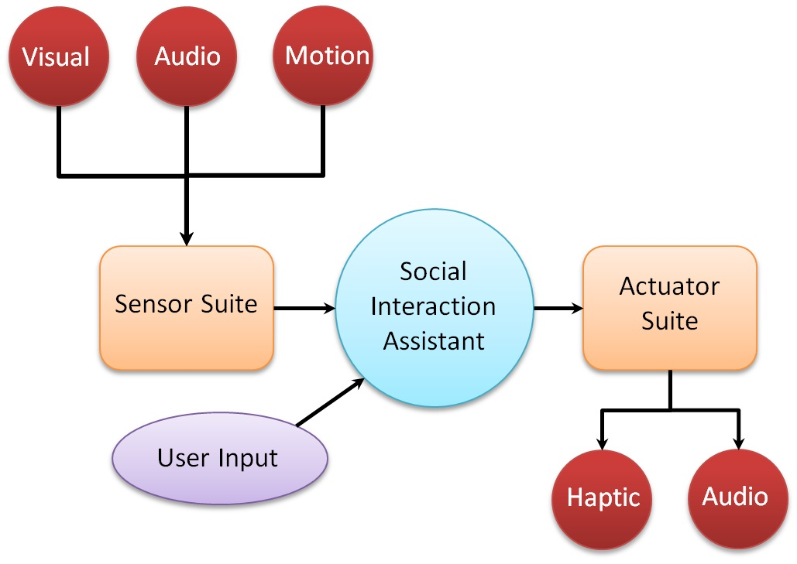
Design Considerations for Social Interaction Aid
Allow seamless and discrete embodiment of sensors
Determine both self and other’s social mannerism
Allow for long term use
Discriminate social stereotypic mannerisms from other functional movements
Be portable and wearable
Does not obstruct user’s abilities

Slide 20
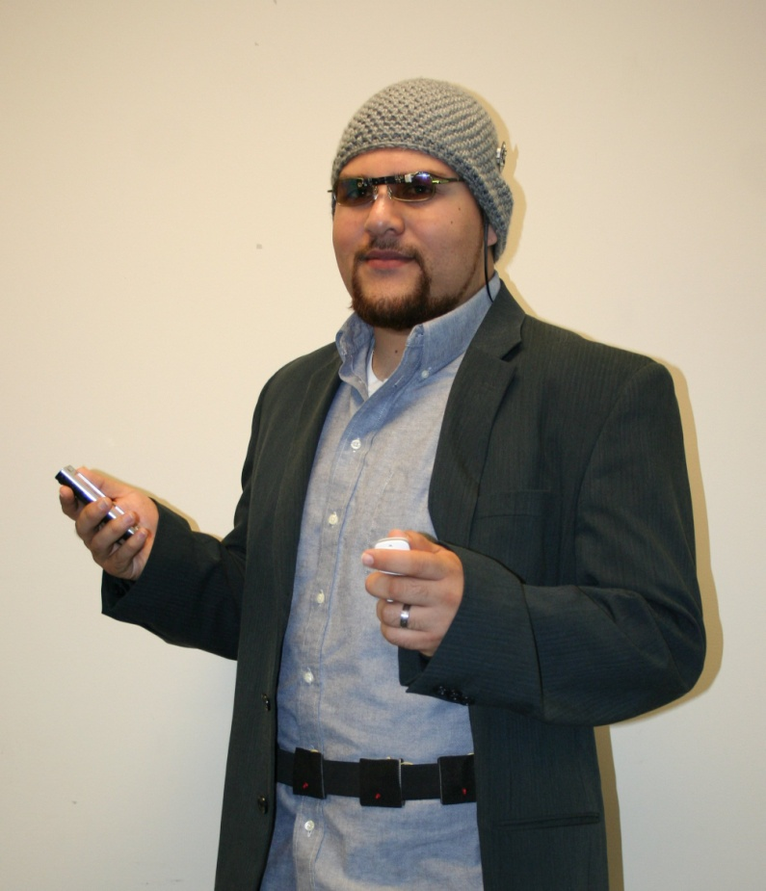
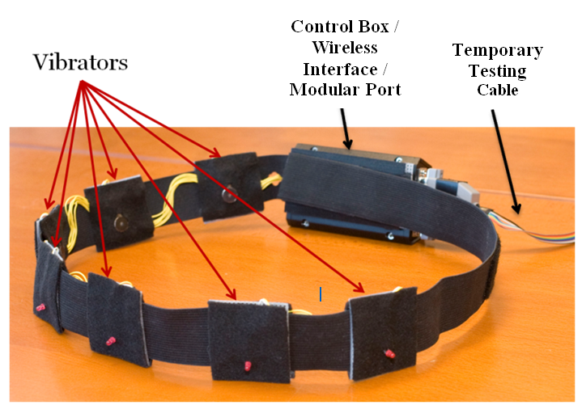
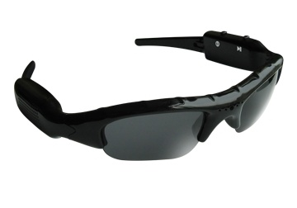


Group Interaction Assistant
Seamless and Discrete
Self and Other sensing
Long term us
Portable and wearable
No Obstructions
Miniature Motion Sensors
User Interface
Wearable Camera
Haptic Belt

Slide 21


Facial Expressions in Non-verbal Communication

Slide 22












Temporal Exemplar-Based Facial Expression Recognition
$$H(t)$$
Prior Knowledge:
$$H\left(t\right)=P\left(Y_{i}(t−1)/\left(X\left(t−1\right), H(t−1)\right)\right)$$
Decision:
$$P\left(Y_{i}(t)/\left(X\left(t\right),H(t)\right)\right)$$
$$i∈\{H,Sa, Su, D, F,A\}$$
Happy
Sad
Surprise
Disgust
Fear
Anger
$$L_{H}(t)$$
$$L_{Sa}(t)$$
$$L_{Su}(t)$$
$$L_{D}(t)$$
$$L_{F}(t)$$
$$L_{A}(t)$$
Exemplar:
$$P(L_{i}(t)/X\left(t\right))$$
$$i∈\{H,Sa, Su, D, F,A\}$$
Observation: $P(X\left(t\right))$
$$X(t)$$

Slide 23




Temporal Exemplar-Based Facial Expression Recognition

Slide 24

Optimization Performance
Angry
Surprise
Disgust
Happy
Sad
Fear
Test Point:
Angry
Disciplined Convex Optimization
Newton Method

Slide 25


What’s going on inside?
Test and Reconstruction

Slide 26



An interface for delivering facial expressions
Rahman et. al. (2008, 2009) – An haptic interface for communicating facial expression information.

Slide 27



Haptic Glove – HCI Testing

Slide 28



Haptic Emoticon Mapping

Slide 29

Dyadic Interaction Assistant

Slide 30





Classifiers & Results
Classic AdaBoost
Modest AdaBoost
Detection within 0.5 seconds of the start of rocking – Average rock period is 2.2 seconds.
Real-time performance on the PDA of the Social Interaction Assistant.
Feedback in audio tones and/or haptic vibrations.
Currently works like a Intervention tool, but can be extended into a self-monitoring aid.

Slide 31
Results
 | FERET | In-house
# actual face images | 14,051 | 2,597
# detections | 6,208 | 2,324
# true detections | 4,420 | 2,074
# false detections | 1,788 (28.8%) | 250 (10.7%)
Metric | Definition
No. of false detections (NFD) | Count of false detections
False detection rate (FDR)
Metric | Definition
Precision (P)
Capacity (C)
 | Before Validation | After Validation
NFD | 1,788 | 208
FDR | 28.8% | 3.35%
P | 0.7120 | 0.9551
C | 0.026 | 0.281
 | Before Validation | After Validation
NFD | 250 | 2
FDR | 10.7% | 0.01%
P | 0.892 | 0.999
C | 0.691 | 0.798
FERET
In-House

Slide 32



Results – Datasets and Evaluation Metrics
Area Overlap (AO):
Distance b.w Centroids (DC):
Tracking Evaluation Measure (Harmonic Mean of AO & DC )
Evaluation Metrics
DataSet 1 (Collected at CUbiC) : Plain Background; Static Camera; 320x240 resolution
DataSet 2 (CASIA Gait Dataset B with subject approaching the camera) : Slightly cluttered Background; Static Camera; 320x240 resolution
DataSet 3 (Collected at CUbiC) : Cluttered Background; Mobile Camera; 320x240 resolution

Slide 33











Results – Example Dataset
#2
#40
#2
#40
Color PF
SMSPF
Clear improvement in tracking results when compared with Numiaro’s Color based particle filtering
Area Overlap Ratio
Distance between Centroids

Slide 34




Facial Expressions and Head Mannerisms
Facial Feature Tracking
Line Segment Features
Head Tracking and Registration

Slide 35



Science Policy Study
US Census Bureau monitors monthly wage as an indicator of socio-economic quality of life.
Analysis of the wage spread for population with disability. (American Community Survey).

Slide 36
Impact
Conferences & Reports:
Journals
Book Chapter
21 conference publications and reports.
5 journals
Person-Specific Characteristic Feature Selection for Face Recognition” in Biometrics – Theory, Methods and Applications
Book
Mediated Social Interpersonal Interactions
Capstone Projects
FURI
High School Students
6 Capstone projects in Comp. Sci. and Eng.
4 undergraduate students
4 high school students trained in real-time human computer interfaces
Broad Area Announcement – Office of Naval Research
NSF
ASU GPSA Award, FURI Funding, Capstone student funding
Novel interface for delivering threat direction, distance and size to soldiers on the field.
3 proposals attempted, Currently 1 in review on “ Assistive Social Situational Awareness Aids for Individuals with Disabilities”
Close to 10K in various funding sources.

Slide 37
Awards & Recognitions
ACM MM 2010
IBM T. J. Watson Research Center
Microsoft Bing Search – Ranking & Relevance Team
Oct 2010, Brave New Ideas Session
Oct 2010, Emerging Leader in Multimedia and Signal Processing
Oct 2010, Industry-Academia interaction session
Raytheon Industry-Academia Meet
April 2010, Technologies for the warfighter conference
Microsoft Imagine Cup
Derived project from the interaction assistant
ASU Innovation Challenge
Undergraduate student team focused on developing novel HCI for doctors

Slide 38


Current Research
Bing Core Search – Ranking & Relevance Team
What frustrates a search engine user?
How to understand and model satisfaction/dissatisfaction of a SE user?
What can the user clicks and behaviors tell us about the user level of satisfaction?
How to consume TBytes of user behavior data?
User data modeling
Search HCI
Information Retrieval
New metrics for comparing search engine performance

Slide 39
Thanks
Dr. Michelle (Lani) Shiota
Mentors
Dr. Panch
Vineeth, CK & Troy
Collaborators
Lab Members
Dr. Terri Hedgpeth
Dr. John Black
Dr. Bhavesh Patel MD
Dr. Terri Hedgpeth
Dr. Dirk Colbry
Lakshmie, Hiranmayi & Lakshmi
Hemanth, Prashanth, Mohammad, Shayok, Rita & Gaurav
Dr. Michelle (Lani) Shiota
Micheal, Mike, Daniel & David
Nathan & Jacob
Steven & Bryan

